Slide 1
ROBOTIC ARM SIMULATION
Presented By Mohammad Rohaan 22I-2327

Slide 2
DH TABLE
JOINTS | LINK LENGTH | ALPHA | D | THETA
1 | A1 | -90 | D1 | THETA1
2 | A2 | 0 | 0 | THETA2
3 | A3 | 0 | 0 | THETA3
4 | 0 | 90 | D4 | THETA4

Slide 3
TASKS OF ASSIGNMENT
03
04
01
02
TRANSFORMATION MATRIX
FORWARD KINEMATICS
INVERSE KINEMATICS
ARM SIMULATION

Slide 4
TRANSFORMATION MATRIX
A transformation matrix is a 4x4 matrix used in robotics to represent both the position and orientation of a link in 3D space relative to another link. It combines rotation and translation, allowing precise calculation of each link's location, enabling the robotic arm's movements to be modeled and controlled accurately.

Slide 5
01
TRANSFORMATION MATRIX
CODE TO FIND TRANSFORMATION MATRIX

Slide 6
prompt = {'Enter theta1 (degrees):', 'Enter theta2 (degrees):', 'Enter theta3 (degrees):', 'Enter theta4 (degrees):'};
theta1 = deg2rad(theta1);
theta2 = deg2rad(theta2);
theta3 = deg2rad(theta3);
theta4 = deg2rad(theta4);
pose = app.forwardKinematics(theta1, theta2, theta3, theta4);
endEffectorPos = pose(1:3, 4);
disp(endEffectorPos);
var = sprintf('[%.1f %.1f %.1f %.1f\n %.1f %.1f %.1f %.1f\n %.1f %.1f %.1f %.1f\n %.1f %.1f %.1f %.1f]', ...
pose(1,1), pose(1,2), pose(1,3), pose(1,4), ...
pose(2,1), pose(2,2), pose(2,3), pose(2,4), ...
pose(3,1), pose(3,2), pose(3,3), pose(3,4), ...
pose(4,1), pose(4,2), pose(4,3), pose(4,4));

Slide 7
if theta(i) < qmin || theta(i) > qmax
sprintf('Joint %d exceeds its limits! Valid range: [%.1f, %.1f]’)
figure('Name', 'SUMO_ROBO', 'NumberTitle', 'off', 'WindowState', 'maximized');
show(puma560, theta, 'Frames', 'off’);
app.TextArea.Value = {output_String};
app.TextArea.Visible = 'on';
pause(5);
app.TextArea.Visible = 'off';
puma560 = loadrobot('puma560', 'DataFormat', 'row', 'Gravity', [0 0 -9.81]);

Slide 8
02
FORWARD KINEMATICS
CODE TO FIND FORWARD KINEMATICS

Slide 9
prompt = {'Enter theta1 (degrees):', 'Enter theta2 (degrees):', 'Enter theta3 (degrees):', 'Enter theta4 (degrees):'};
theta1 = deg2rad(theta1);
theta2 = deg2rad(theta2);
theta3 = deg2rad(theta3);
theta4 = deg2rad(theta4);
JN = [theta1, theta2, theta3, theta4, 0, 0];
for i = 1:length(JN)
qmin = JN(i, 1);
if JN(i) < qmin
sprintf('Joint %d exceeds its limits!’);
return;
end

Slide 10
EN = 'link4’;
position = transl(EN);
if app.isSingular(JN)
sprintf(‘LOST ONE ANGLE', position(1), position(2), position(3));
end
output_String = sprintf('\n\n End Effector Position:\n\nX = %.2f\nY = %.2f\nZ = %.2f', position(1), position(2), position(3));
app.TextArea.Value = {output_String};
app.TextArea.Visible = 'on';
app.TextArea.Visible = 'off';
figure('Name', 'SOMO', 'NumberTitle', 'off', 'WindowState', 'maximized');
show(p560, JN);

Slide 11
03
INVERSE KINEMATICS
CODE TO FIND INVERSE KINEMATICS

Slide 12
prompt = {'Enter X position:', 'Enter Y position:', 'Enter Z position:’};
r = sqrt(x^2 + y^2);
if r < 0.5 || r > 1
sprint('Position is outside the radial limits ');
return;
elseif theta < -90 || theta > 90
sprint('Position is outside the angular limits ');
return;
elseif z < 0
sprint('Z-position must be non-negative.', 'Workspace Error');
return;
end

Slide 13
JN = ik('link6’, EN, weights, zeros(1, 6));
output_String = sprintf(rad2deg(jointAngles(1)), rad2deg(jointAngles(2)), rad2deg(jointAngles(3)), rad2deg(jointAngles(4)), rad2deg(jointAngles(5)), rad2deg(jointAngles(6)));
app.TextArea.Visible = 'on';
pause(5);
app.TextArea.Visible = 'off';
figure('Name', ‘SUMO_ROBO', 'NumberTitle', 'off', 'WindowState', 'maximized');
show(p560, jointAngles);

Slide 14
04
SIMULAION
CODE FOR SIMULAION

Slide 15
dh_table = {
'1', '0', '0.2', '0.5', '-90';
'2', '0', '0', '0.5', '0';
'3', '0', '0', '0.5', '0';
'4', '0', '0.1', '0', '-90';
'5', '0', '0', '0', '90';
'6', '0', '0', '0', '0'
};
dh = uifigure('Name', 'DH Table', 'NumberTitle', 'off');
dh.WindowState = 'maximized';

Slide 16
T0 = eye(4);
T1 = transl(1, 2, 3) * rpy2tr(0.6, 0.8, 1.4);
figure;
trplot(T0);
hold on;
trplot(T1);
T_current = transl(S(idx, :)) * rpy2tr(0.6, 0.8, 1.4);
trplot(T_current);

Slide 17
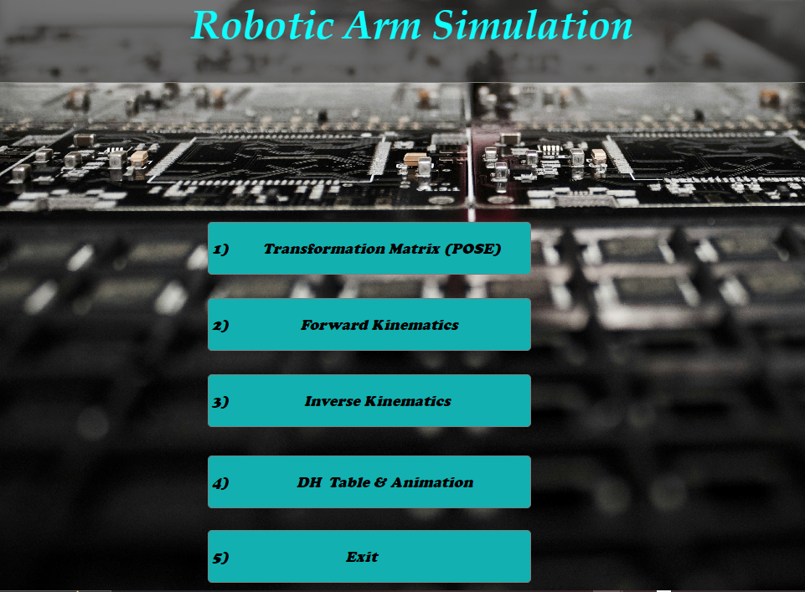
PRODUCT OVERVIEW
JUPITER
MERCURY
NEPTUNE
Jupiter is the biggest planet of them all
Mercury is the closest planet to the Sun
Neptune is the farthest planet from the Sun
EARTH
VENUS
SATURN
Earth is the only planet that harbors life
Venus is the second planet from the Sun
Saturn is composed of hydrogen and helium

Slide 18
